Slide 1
PREDICTION OF HEART DISEASE USING MACHINE LEARNING
By
NITESH KUMAR(13BCE0789)
HARSH VARDHAN(13BCE0454)

Slide 2
AIM
Today in this world there are many people who dies because of heart attacks and some of them because they find it too late to be cured. Aim of this work is to predict the heart disease patient if any so that there will be ample time to cure it or to find the cure.

Slide 3
Objective
The main objective of this project is predicting the cardio vascular disease risk level of a patient using machine learning algorithms, Introduction of Probabilistic Analysis and Classification (PAC), Comparison of Probabilistic Analysis and Classification (PAC) with existing Machine Language Algorithms and creating a specific System for both doctors and patients to login and view the data on Cloud platform.

Slide 4
Motivation
In today’s world there are many scientific technologies which helps doctors in taking important decisions but they might not be accurate. Heart disease prediction system can assist medical professionals in predicting state of heart, based on the clinical data of patients fed into the system. Predicting of the heart disease is a very complex task in this world. Prediction of heart disease is a major challenge faced by hospitals and medical centers, especially when it comes to accuracy.
The hospitals collects huge amounts of data which is not possible to handle manually. With the huge growing population, the doctors and experts available are not in proportion with the population.

Slide 5
Introduction
Categorization techniques of Data Mining and Machine Learning Algorithms play important part in predicting as well as data mining. Also, symptoms of cardio disease may not be important and thus are many times ignored. Big Data like records of patients is handled using Hadoop Map Reduce technique. Different types of study of the machine learning algorithms is done and graphical representation of the results is provided for easier understanding.

Slide 6
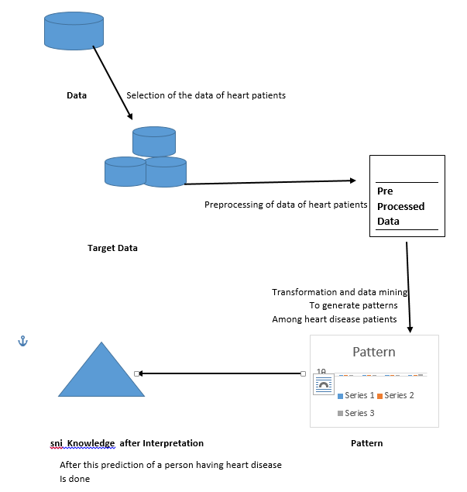
Architecture

Slide 7
IMPLEMENTATION
For implementing this we have used these methods:
i) Naïve Bayes algorithm
ii) Decision Tree
iii)k-nearest neighbor

Slide 8
Naïve Bayes
In this we assumes various kinds of data set and according to that assumption we get a most desired result. It is a simple probabilistic classifier. This classification requires some intense and scalable linear parameters in form of variable. The Bayesian Classification depicts a supervised learning method as well as a statistical method for classification .In this we can use maximum likelihood training method which can be done in evaluating a closed form expression which takes linear time rather than iterative approximation.

Slide 9
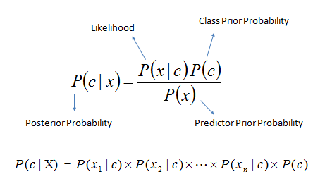

Slide 10
Algorithm
Given training data set D which consists of documents belongings to different classes say A and B.
Calculate the prior probability of class A=number of objects of class A/total no of objects , Calculate the prior probability of class B=number of objects of class B/total no of objects
Find ni, the total number of word frequency of each class
Na= The total number of word frequency of class A
Nb= The total number of word frequency of class B
Find conditional occurrence of keyword given in a class p(word1/class A)=wordcount/ni(A) like these for others also
Avoid zero frequency problems by applying uniform distribution
Classify a new document C based on the probability p(C/W)
Assign document to class that has highest probability

Slide 11
Decision Tree
A Decision tree uses a tree like graph structure which means it includes a root node, branches and a leaf node. Each internal nodes denotes a test on an attribute, each branch denotes the outcome of a test, and each leaf node holds a class label. The topmost node in the tree is the root node. Generally decision tree are used in making analytical decisions which can reach us to our goal in most effective way but also an effective tool for machine learning . The paths from root to leaf represents classification rules.

Slide 12
K-nearest neighbor
The k-closest neighbors calculation (k-NN) is a non-parametric technique utilized for order and revert. In both cases, the data comprises of the k nearest preparing cases in the component space . The output relies on upon whether k-NN is utilized for grouping or revert, k-NN is a sort of example based learning, where the capacity is just approximated locally and all calculation is conceded until arrangement

Slide 13
Algorithm
      In k-NN classification, the output is a class membership.
      An object is classified by a majority vote of its neighbors,
      with the object being assigned to the class most common among its k nearest neighbors
      (k is a positive integer, typically small). If k = 1, then the object is simply assigned to the class
      of that single nearest neighbor.
      In k-NN regression, the output is the property value for the object.
      This value is the average of the values of its k nearest neighbors.

Slide 14
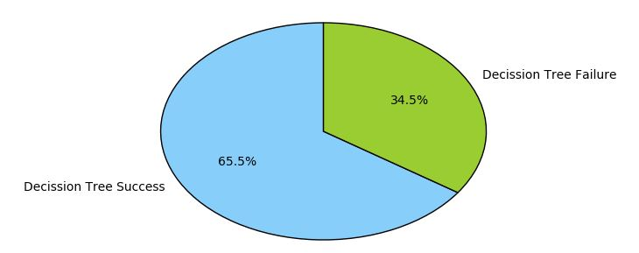
Demonstration

Slide 15
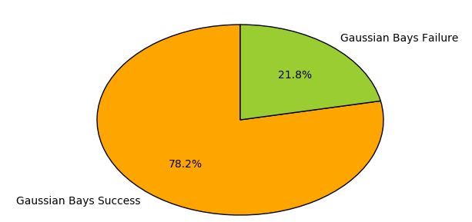
Demonstration

Slide 16
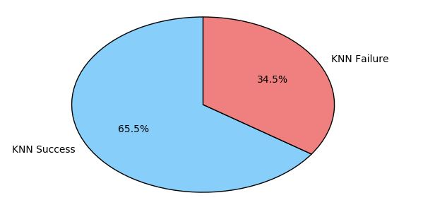
Demonstration

Slide 17
Conclusion
The goal of our work is to give an investigation of various information mining strategies that can be utilized in computerized coronary illness expectation frameworks. Different strategies and information mining classifiers are characterized in this work which has developed as of late for productive and powerful coronary illness conclusion. The examination demonstrates that distinctive advances are utilized as a part of the considerable number of papers with taking diverse number of properties. In this way, unique advancements utilized demonstrated the distinctive exactness to each other.

Slide 18
References
[1] Prerana THM, Shivaprakash N C, Swetha N , Prediction of heart disease using machine learning algorithms-Naïve bayes , Introduction to PAC algorithm, Comaprison of algorithms and HDPS. International journal of science and engineering . November 2, 2015
[2] Sonam Nikhar, A.M Karandikar International journal of advanced engineering, Management and Science . June 6,2016
[3]Jaymin Patel, Prof.TejalUpadhyay, Dr. Samir Patel ,Heart disease prediction using machine learning technique and data mining,IJCSC,MARCH-2016
[4]S.Florence, N.G.Bhuvaneswari Amma, G.Annapoorani, K.Malathi, Predicting the Risk of Heart Attacks using Neural Network and Decision Tree International Journal of Innovative Research in Computer and Communication Engineering-NOVEMBER 2000
[5]Vikas Chaurasia, Saurabh Pal, Early Prediction of Heart Diseases Using Data Mining Techniques, Caribbean Journal of Science and Technology, september-2016
[6] R. Chitra and Dr.V. Seenivasagam, Heart Disease Prediction System Using Supervised Learning Classifier, Bonfring International Journal of Software Engineering and Soft Computing,March-2013

Slide 19
THANK YOU

